Slide 1
U204206B-Digital Electronics – Spring 2022
Combinational Logic Design Process and Common Combinational Components

Slide 2

Digital Logic – Combinational Logic
Combinational Logic Design Process
2.7
Step
Step 1 Capture the
function
Description
Create a truth table or equations, whichever is most natural for the given problem, to describe the desired behavior of the combinational logic.
This step is only necessary if you captured the function using a truth table instead of equations. Create an equation for each output by ORing all the minterms for that output. Simplify the equations if desired.
For each output, create a circuit corresponding to the output’s equation. (Sharing gates among multiple outputs is OK optionally.)
Step 2 Convert to
equations
Step 3 Implement
as a gate- based circuit
3

Slide 3
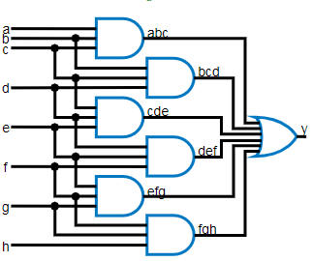
Digital Logic – Combinational Logic
Combinational Logic Design Process Example: Three 1s Detector
Problem: Detect three consecutive 1s
in 8-bit input: abcdefgh
00011101 → 1
11110000 → 1
10101011 → 0
Step 1: Capture the function
Truth table or equation?
□ Truth table too big: 2^8=256 rows
a
a
□ Equation: create terms for each possible _{a}
case of three consecutive 1s
y = abc + bcd + cde + def + efg + fgh
Step 2: Convert to equation -- already done
Step 3: Implement as a gate-based circuit
4

Slide 4
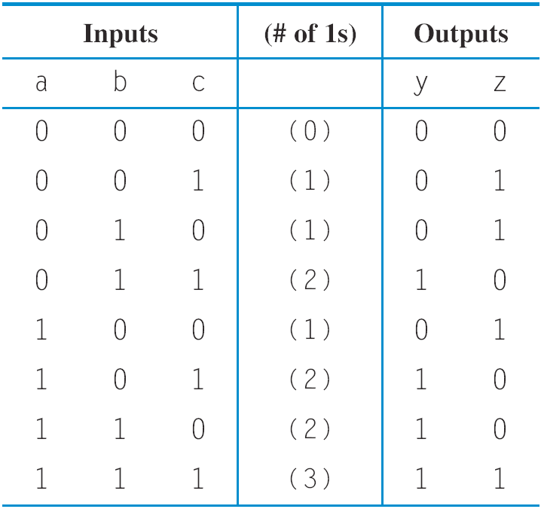

Digital Logic – Combinational Logic
Combinational Logic Design Process Example: Number of 1s Count
Problem: Output in binary on
two outputs yz the number of 1s on three inputs
010 → 01 101 → 10 000 → 00
Step 1: Capture the function
Truth table or equation?
□ Truth table is straightforward
Step 2: Convert to equation
y = a’bc + ab’c + abc’ + abc
a
z = a’b’c + a’bc’ + ab’c’ + abc
□ Step 3: Implement as a gate- based circuit
b c
a b
_{y} c
a
b c
a
b c
a b
z
a
b c
a
b c
5

Slide 5




Digital Logic – Combinational Logic
More Gates
2.8
1
1
NAND NOR XOR XNOR
NAND
NOR
x x
x
F _{y} F ^{x}
y
y
F
y
x y F
0 0 1
x y F
0 0 1
x y F
0 0 0
x y F
0 0 1
x
F
y
0 1 1
0 1 0
0 1 1
0 1 0
x
1 0 1
1 0 0
1 0 1
1 0 0
y
1 1 0 1 1 0 1 1 0 1 1 1
0 0
NAND same as AND with power & ground switched
Why? nMOS conducts 0s well, but not 1s (reasons beyond our scope) -- so NAND more efficient
Likewise, NOR same as OR with power/ground switched
AND in CMOS: NAND with NOT
OR in CMOS: NOR with NOT
So NAND/NOR more common
6
NAND: Opposite of AND (“NOT AND”)
NOR: Opposite of OR (“NOT OR”)
XOR: Exactly 1 input is 1, for 2-input
XOR. (For more inputs -- odd number of 1s)
XNOR: Opposite of XOR (“NOT XOR”)

Slide 6
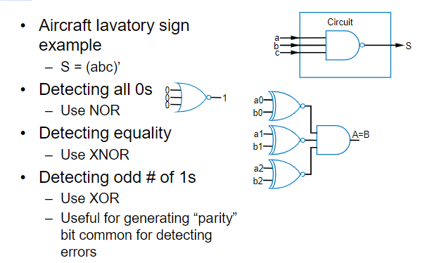
Digital Logic – Combinational Logic
More Gates: Example Uses
7

Slide 7


Digital Logic – Combinational Logic
Completeness of NAND
Any Boolean function can be implemented using just NAND gates. Why?
Need AND, OR, and NOT
NOT: 1-input NAND (or 2-input NAND with inputs tied together)
AND: NAND followed by NOT
OR: NAND preceded by NOTs
Likewise for NOR
7

Slide 8
Digital Logic – Combinational Logic
Number of Possible Boolean Functions
How many possible functions of 2 variables?
a
b
F
2 rows in truth table, 2 choices for each
2⁽²²⁾ = 2⁴ = 16 possible functions
N variables
2^{N} rows
2^{(2N)} possible functions
0
0
0 or 1 2 choices
2
0 | 1 | 0 or 1 2 choices
1 | 0 | 0 or 1 2 choices
1 | 1 | 0 or 1 2 choices
 |  | 2⁴ = 16 possible functions
a | b | f0 | f1 | f2 | f3 | f4 | f5 | f6 | f7 | f8 | f9 | f10 | f11 | f12 | f13 | f14 | f15
0 | 0 | 0 | 0 | 0 | 0 | 0 | 0 | 0 | 0 | 1 | 1 | 1 | 1 | 1 | 1 | 1 | 1
0 | 1 | 0 | 0 | 0 | 0 | 1 | 1 | 1 | 1 | 0 | 0 | 0 | 0 | 1 | 1 | 1 | 1
1 | 0 | 0 | 0 | 1 | 1 | 0 | 0 | 1 | 1 | 0 | 0 | 1 | 1 | 0 | 0 | 1 | 1
1 | 1 | 0 | 1 | 0 | 1 | 0 | 1 | 0 | 1 | 0 | 1 | 0 | 1 | 0 | 1 | 0 | 1
0 a AND b a b a XOR b a OR b a NOR b a XNOR b b’ a’ a NAND b 1
8

Slide 9



Digital Logic – Combinational Logic
Decoders and Muxes
2.9
Decoder: Popular combinational logic building block, in addition to logic gates
Converts input binary number to one high output
2-input decoder: four possible input binary numbers
So has four outputs, one for each possible input binary number
Internal design
d0 1 d0 0 d0 0 d0 0
0 i0 d1 0 1 i0 d1 1 0 i0 d1 0 1 i0 d1 0
0 i1 d2 0 0 i1 d2 0 1 i1 d2 1 1 i1 d2 0
d3 0 d3 0 d3 0 d3 1
i1’i0’
d0
d0
i0 d1
i1 d2
_{e} d3
0
0
0
1
1
1
i1’i0
d1
□ AND gate for each output to detect input combination
Decoder with enable e
Outputs all 0 if e=0
Regular behavior if e=1
n-input decoder: 2^{n} outputs
i1i0’ d2
1
i1i0
d3
d0
i0 d1
i1 d2
_{e} d3
0
0
0
0
1
1
i1 i0
0
9

Slide 10
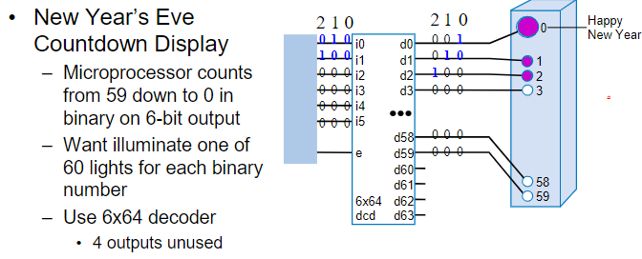
Digital Logic – Combinational Logic
Decoder Example
10

Slide 11
Digital Logic – Combinational Logic
N-bit Mux
What output of a 3x8 decoder will be asserted if i2i1i0 = 110?
1. d0 = 1
2. d3 = 1
3. d6 = 1
4. d7 = 1
d0 d1 d2 d3 d4 d5 d6 d7
i0 i1 i2
3x8 dec
10

Slide 12
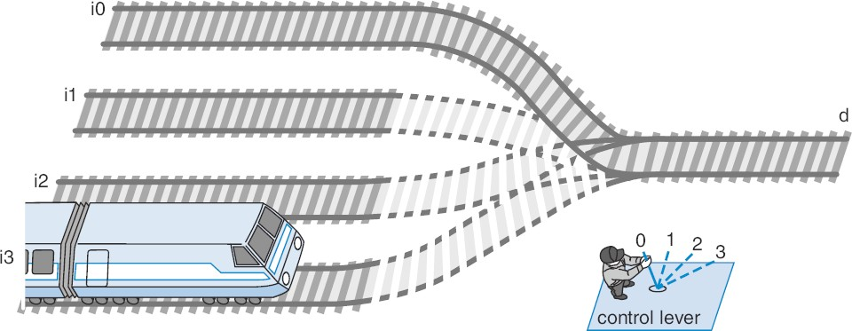
Digital Logic – Combinational Logic
Multiplexor (Mux)
Mux: Another popular combinational building block
Routes one of its N data inputs to its one output, based on binary value of select inputs
4 input mux → needs 2 select inputs to indicate which input to route through
8 input mux → 3 select inputs
N inputs → log₂(N) selects
Like a railyard switch
11

Slide 13



Digital Logic – Combinational Logic
Mux Internal Design
i0
i0 (1*i0=i0)
d
i0
2×1
2×1
2×1
1
i0 i1
i0 i1
i0 i1
i1
d
d
d
0
(0+i0=i0)
0
s0
s0
0
s0
1
a
2x1 mux
0 s0
i0
4⋅ 1
i0 i1 i2 i3
i1
d
d
i2
s1 s0
i3
4x1 mux
s1 s0
12

Slide 14
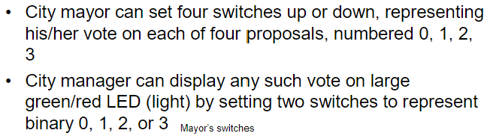
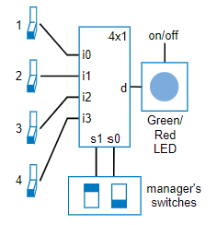

Digital Logic – Combinational Logic
Mux Example
12

Slide 15
Digital Logic – Combinational Logic
N-bit Mux
Example: Two 4-bit inputs, A (a3 a2 a1 a0), and B (b3 b2 b1 b0)
□ 4-bit 2x1 mux (just four 2x1 muxes sharing a select line) can select between A or B
a3 b3
_{i0} 2⋅ 1
Simplifying notation: 4
C
i1
d
s0
_{i0} 2⋅ 1
4
A
4
B
4-bit
_{I0} 2x1
D
I1
s0
a2 b2
d
4
i1
s0
C
is short for
a1 b1
_{i0} 2⋅ 1
i1
d
c3
c2
c1 c0
s0
2⋅ 1
s0
a0 b0
i0
d
i1 _{s0}
s0
13

Slide 16
Digital Logic – Combinational Logic
N-bit Mux
If A=5, B=2, what is the output of the 4-bit 2x1 mux if s0 = 1?
1. 0
2. 5
3. 2
4. 7
4
A
4
B
4-bit
_{I0} 2x1
D
I1
s0
4
C
s0
14

Slide 17
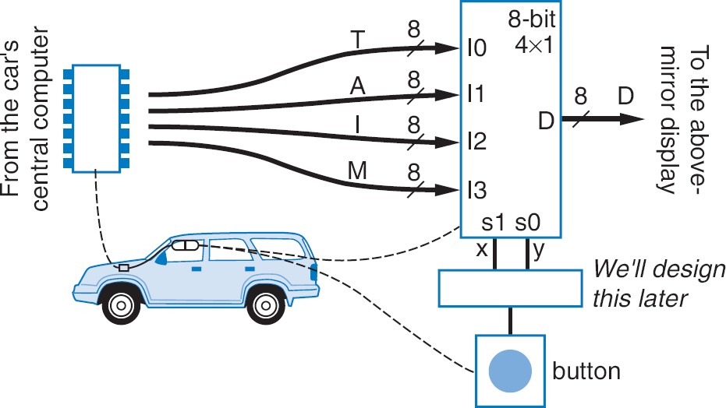
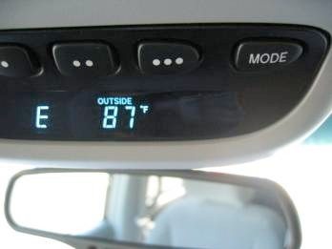
Digital Logic – Combinational Logic
N-bit Mux Example
Four possible display items
Temperature (T), Average miles-per-gallon (A), Instantaneous mpg (I), and Miles remaining (M) -- each is 8-bits wide
Choose which to display using two inputs x and y
Use 8-bit 4x1 mux
15

Slide 18
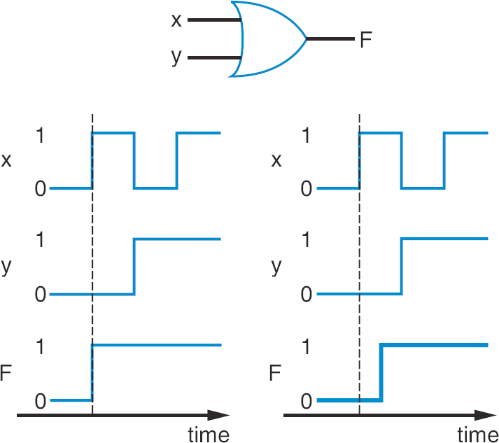
Digital Logic – Combinational Logic
Non-Ideal Gate Behavior -- Delay
Real gates have some delay
□ Outputs don’t change immediately after inputs change
16

Slide 19
Digital Logic – Combinational Logic
Encoders
Encoder: Combinational logic building block with opposite functionality of decoder
Outputs binary encoding for input signal that is 1
4x2 encoder would have four inputs and 2 outputs
1 d0 0 d0 0 d0 0 d0
0 d1 e0 0 1 d1 e0 1 0 d1 e0 0 0 d1 e0 1
0 d2 e1 0 0 d2 e1 0 1 d2 e1 1 0 d2 e1 1
0 d3 0 d3 0 d3 1 d3
What if two inputs are 1?
Can use a priority encoder
Gives priority to the highest input that is 1, and outputs binary encoding for that input
Example: If d3=1 and d1=1, will output e0=1 and e1=1 because d3 has priority
0 d0
1 d1 e0 1
0 d2 e1 1
1 d3
17

Slide 20
Digital Logic – Combinational Logic
In Class Exercise
Design a 4x2 encoder using AND, OR, and NOT gates.
18

